Slide 1
Frontend Development AngularJS
Pregatit de: Alexandru Dima Data: 20.10.2014

Slide 2
Topics - Angular Js Directives - Forms - Filters
Pregatit de: Alexandru Dima Data: 20.10.2014

Slide 3
Angular Js Directives
ng-change
ng-class
ng-options

Slide 4
ng-change
Built-in AngularJS directive
Used to evaluate the given expression when the user changes the input.
The expression is evaluated immediately, unlike the JavaScript onchange event which only triggers at the end of a change
this directive requires ng-model to be present.
The ng-change expression is only evaluated when a change in the input value causes a new value to be committed to the model.

Slide 5
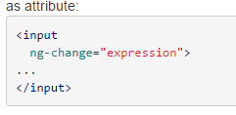
ng-change
$scope.counter = 0;
$scope.change = function() {
$scope.counter++;
};
$scope. confirmed;
<input type="checkbox" ng-model="confirmed"
ng-change="change()" />

Slide 6
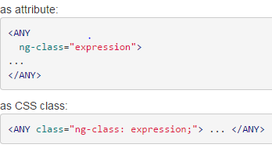
ng-class
Built-in AngularJS directive
The ng-class directive allows you to dynamically set CSS classes on an HTML element by databinding an expression that represents all classes to be added
The result of the evaluation can be a string representing space delimited class names, an array, or a map of class names to boolean values. In the case of a map, the names of the properties whose values are truthy will be added as css classes to the element.

Slide 7
ng-class
Example 1 :
$scope.hasError = true;
…
<div class="form-group" ng-class="{ 'has-error': hasError}">
Example 2:
$scope.hasError = 'has-error;
…
<div class="form-group" ng-class=“hasError ">

Slide 8
ng-options
Built-in AngularJS directive
Used to generate <option> elements for a <select> element
Iterates an array or an object and generates a <option> element for each item
Used with ng-model directive

Slide 9
ng-options
ng-options expression should have one of the following forms
for array data sources:
label for value in array
select as label for value in array
label group by group for value in array
select as label group by group for value in array track by trackexpr
for object data sources:
label for (key , value) in object
select as label for (key , value) in object
label group by group for (key, value) in object
select as label group by group for (key, value) in object
Notes:
array / object: an expression which evaluates to an array / object to iterate over.
value: local variable which will refer to each item in the array or each property value ofobject during iteration.
key: local variable which will refer to a property name in object during iteration.
label: The result of this expression will be the label for <option> element. Theexpression will most likely refer to the value variable (e.g. value.propertyName).
select: The result of this expression will be bound to the model of the parent <select>element. If not specified, select expression will default to value.
group: The result of this expression will be used to group options using the <optgroup>DOM element.
disable: The result of this expression will be used to disable the rendered <option>element. Return true to disable.
trackexpr: Used when working with an array of objects. The result of this expression will be used to identify the objects in the array. The trackexpr will most likely refer to the value variable (e.g. value.propertyName). With this the selection is preserved even when the options are recreated (e.g. reloaded from the server).

Slide 10
ng-options
$scope.colors = [
{name:'black', shade:'dark'},
{name:'white', shade:'light'},
{name:'red', shade:'dark'},
{name:'blue', shade:'dark'},
{name:'yellow', shade:'light'}
];
<select ng-model="myColor" ng-options="color.name for color in colors">
</select>
<select ng-model="myColor" ng-options="color.name group by color.shade for color in colors">
</select>

Slide 11
ng-options
$scope.cities = {
75000: 'Paris',
69000: 'Lyon',
89100: 'Auxerre' };
<select ng-model="myCity" ng-options=“value for (key, value) in cities"></select>

Slide 12
Workshop: Angular Js Directives

Slide 13
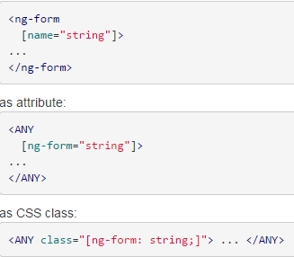
ng-form
Built-in AngularJS directive
Directive that instantiates FormController.
Similar to <form> element from HTML
Can be used as element, attribute or css class
Can be nested inside another ng-form directive
Useful for validation of forms
‘name’ attribute is used to publish to current scope form controller

Slide 14
ng-form
Elements:
input(text, number, email, checkbox, radio,…)
select
textarea
Notes:
You can use one of the following two ways to specify what javascript method should be called when a form is submitted:
ngSubmit directive on the form element
ngClick directive on the first button or input field of type submit (input[type=submit])

Slide 15
ng-form
Properties:
$pristine
$dirty
$valid
$invalid
$submitted
$error
$error Is an object hash, containing references to controls or forms with failing validators like:
email
max
maxlength
min
minlength
number
pattern
required
url
date
datetimelocal
time
week
month

Slide 16
ng-form
<ng-form name="myForm" ng-controller="FormController" class="my-form">
userType: <input name="input" ng-model="userType" required>
<span class="error" ng-show="myForm.input.$error.required">Required!</span><br>
userType = {{userType}}<br>
myForm.input.$valid = {{myForm.input.$valid}}<br>
myForm.input.$error = {{myForm.input.$error}}<br>
myForm.$valid = {{myForm.$valid}}<br>
myForm.$error.required = {{!!myForm.$error.required}}<br>
</ng-form>

Slide 17
Workshop: Angular Js Forms

Slide 18
filters
Filter components in ng:
orderBy - Orders a specified array by the expression predicate.
date - Formats date to a string based on the requested format
filter - Selects a subset of items from array and returns it as a new array.
lowercase - Converts string to lowercase.
uppercase - Converts string to uppercase.

Slide 19
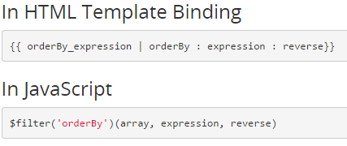
filters
$scope.colors = [
{name:'black', shade:'dark'},
{name:'white', shade:'light'},
{name:'red', shade:'dark'},
{name:'blue', shade:'dark'},
{name:'yellow', shade:'light'}
];
<tr ng-repeat="employee in employees | orderBy:'name'">

Slide 20
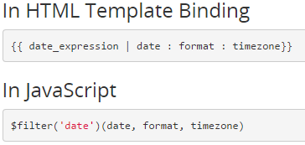
filters
$scope.currentDate = new Date();
<li><a>Date: {{currentDate | date:'yyyy-MM-dd'}}</a></li>

Slide 21
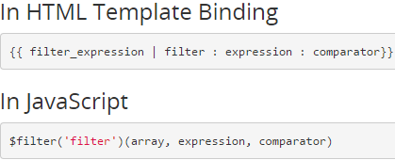
filters
$scope.friends = [{name:'John', phone:'555-1276'},
{name:'Mary', phone:'800-BIG-MARY'},
{name:'Mike', phone:'555-4321'},
{name:'Adam', phone:'555-5678'},
{name:'Julie', phone:'555-8765'},
{name:'Juliette', phone:'555-5678'}]
<div ng-repeat="friend in friends | filter:searchText">
….
</div>

Slide 22
Workshop: AngularJS Filters

Slide 23
Questions?

Slide 24
Thank you!

